Slide 1
MAJOR MACHINE LEARNING PROJECT
Heart Disease Prediction
Using Machine Learning
Objective
Predict whether a patient is likely to have heart disease based on clinical features.
Machine Learning Models
01
02
Logistic Regression
Decision Tree

Slide 2
Project Objective
The main objective of this project is to develop a machine-learning classification system that can predict the likelihood of heart disease.
Clean and preprocess the Heart Disease dataset
Handle missing values
1
2
Encode categorical features
Scale numerical features
3
4
Train classification models
Evaluate model performance
5
6
Visualize predictions using a confusion matrix and ROC curve
Select the better-performing model
7
8

Slide 3
Dataset
920
16
Heart Disease UCI Dataset
Source: Kaggle – Heart Disease UCI
Patient Records
Original Columns
ORIGINAL COLUMNS
id
age
sex
TARGET VARIABLE
num
dataset
cp
trestbps
Converted into binary classification:
chol
fbs
restecg
0
No Heart Disease
thalch
exang
oldpeak
1
Heart Disease
slope
ca
thal
Original values 1–4 (varying severity) were collapsed into class 1.

Slide 4
Data Preprocessing
The following preprocessing steps were performed on the dataset before training.
1
Remove Unnecessary Columns
2
Handle Missing Values
id and dataset were removed because they were not useful for prediction.
Numerical features → Median imputation
Categorical features → Mode imputation
ca was retained and its missing values were handled using median imputation.
3
Encode Categorical Features
4
Feature Scaling
One-hot encoding was applied using pd.get_dummies()
StandardScaler was applied before training Logistic Regression.

Slide 5
Machine Learning Pipeline
Heart Disease Dataset
Data Cleaning
Missing Value Handling
Feature Encoding
Train / Test Split
Feature Scaling
Logistic Regression
Decision Tree
Predictions
Predictions
Model Evaluation
Accuracy • Precision • Recall
Confusion Matrix • ROC Curve
Final Model Selection

Slide 6
Models Used
Logistic Regression
Decision Tree
Used as a classification model.
Predicts the probability of heart disease.
Feature scaling was applied before training.
Uses decision rules to classify patients.
Can capture non-linear relationships.
Does not require feature scaling.
Why use two models? Both models were trained and evaluated to determine which performed better on the test data.

Slide 7
Evaluation Metrics
The models were evaluated using four main metrics.
1
2
3
4
Accuracy
Precision
Recall
ROC-AUC
Measures the overall percentage of correct predictions.
Measures how many patients predicted as having heart disease actually belonged to the heart-disease class.
Measures how many actual heart-disease cases were correctly identified.
Measures how well the model distinguishes between the two classes.

Slide 8
Model Performance
Actual results on the held-out test set.
BEST MODEL
Logistic Regression
84.24%
Accuracy
84.11%
Precision
88.24%
Recall
Decision Tree scored 78.26% accuracy, 80.39% precision, and 80.39% recall — lower across all three metrics.

Slide 9
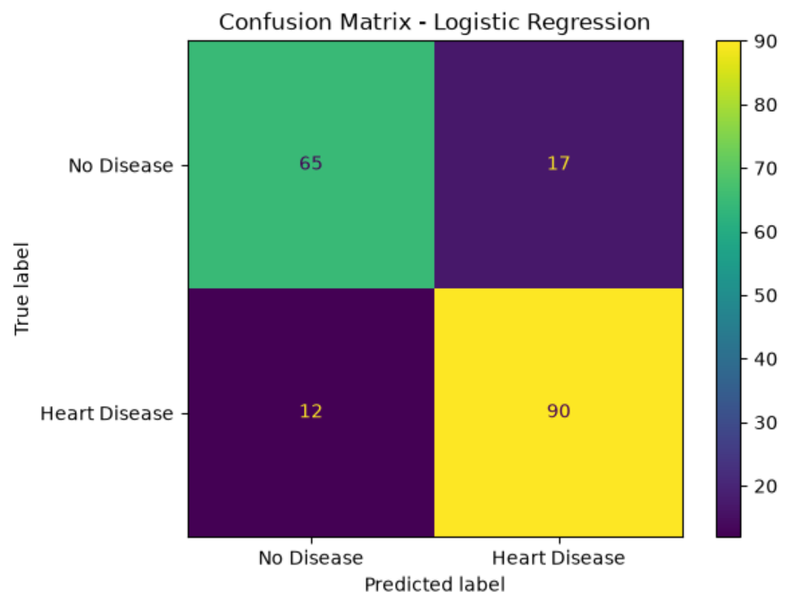
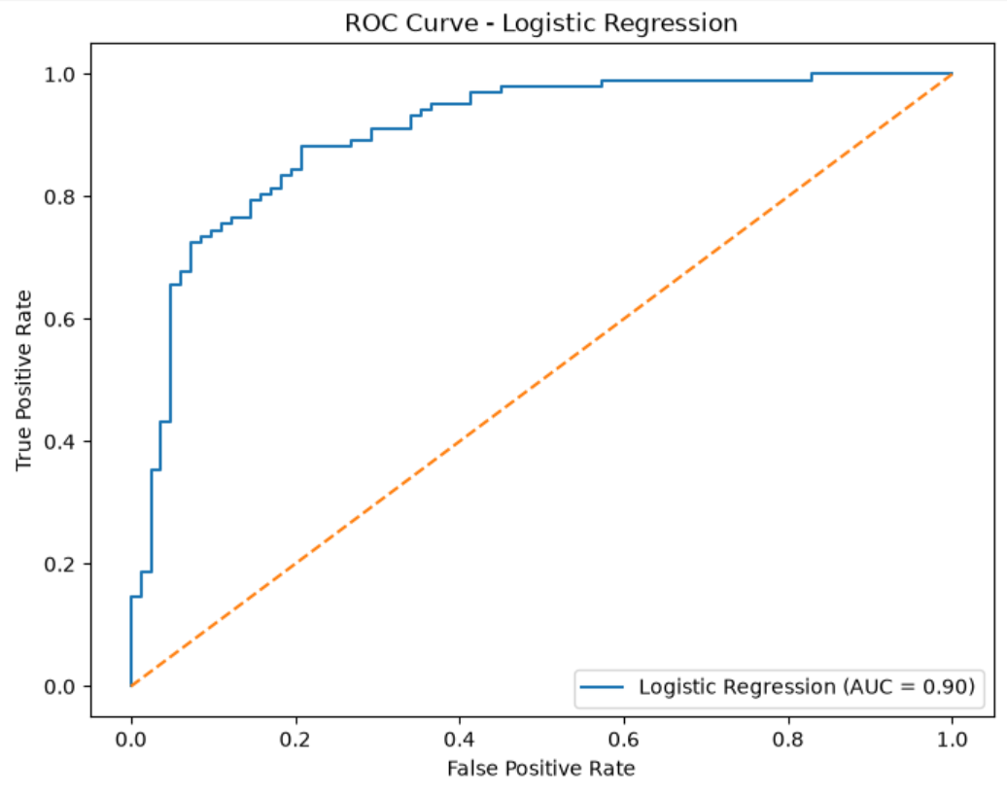
Confusion Matrix & ROC Curve
CONFUSION MATRIX
ROC CURVE
The confusion matrix shows True Negatives, False Positives, False Negatives, and True Positives.
The Logistic Regression model achieved ROC-AUC = 0.9032 — indicating good separation between the two target classes.

Slide 10
Conclusion & Future Scope
CONCLUSION
A complete machine-learning pipeline was successfully implemented for heart disease prediction.
FUTURE SCOPE
1
Hyperparameter tuning
Missing-value handling
Feature encoding
Feature scaling
Train / test splitting
2
Cross-validation
3
Testing on larger and more diverse datasets
Two models were evaluated, and Logistic Regression performed better.
Development of an interactive web interface
4
FINAL PERFORMANCE
5
Further validation before any real-world clinical use
84.24%
84.11%
88.24%
90.32%
Accuracy
Precision
Recall
ROC-AUC
Note: This project is for educational purposes and is not a medical diagnostic system.

